Slide 1
Swipe down
multiple
targets?
Scan
Tap
Coarse
Refinement
Acquired
a single
target?

Slide 2
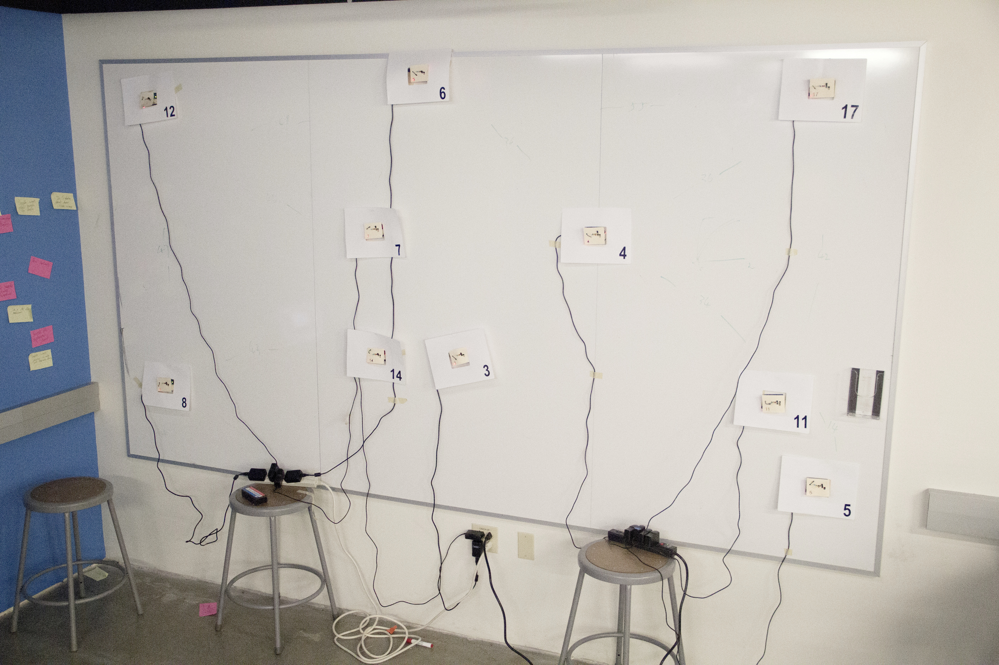
1.8 m
3.4 m

Slide 3
0.9 m

Slide 4
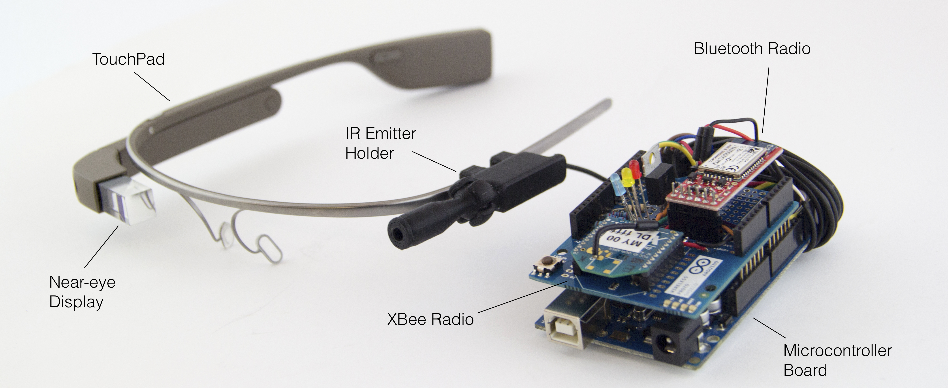
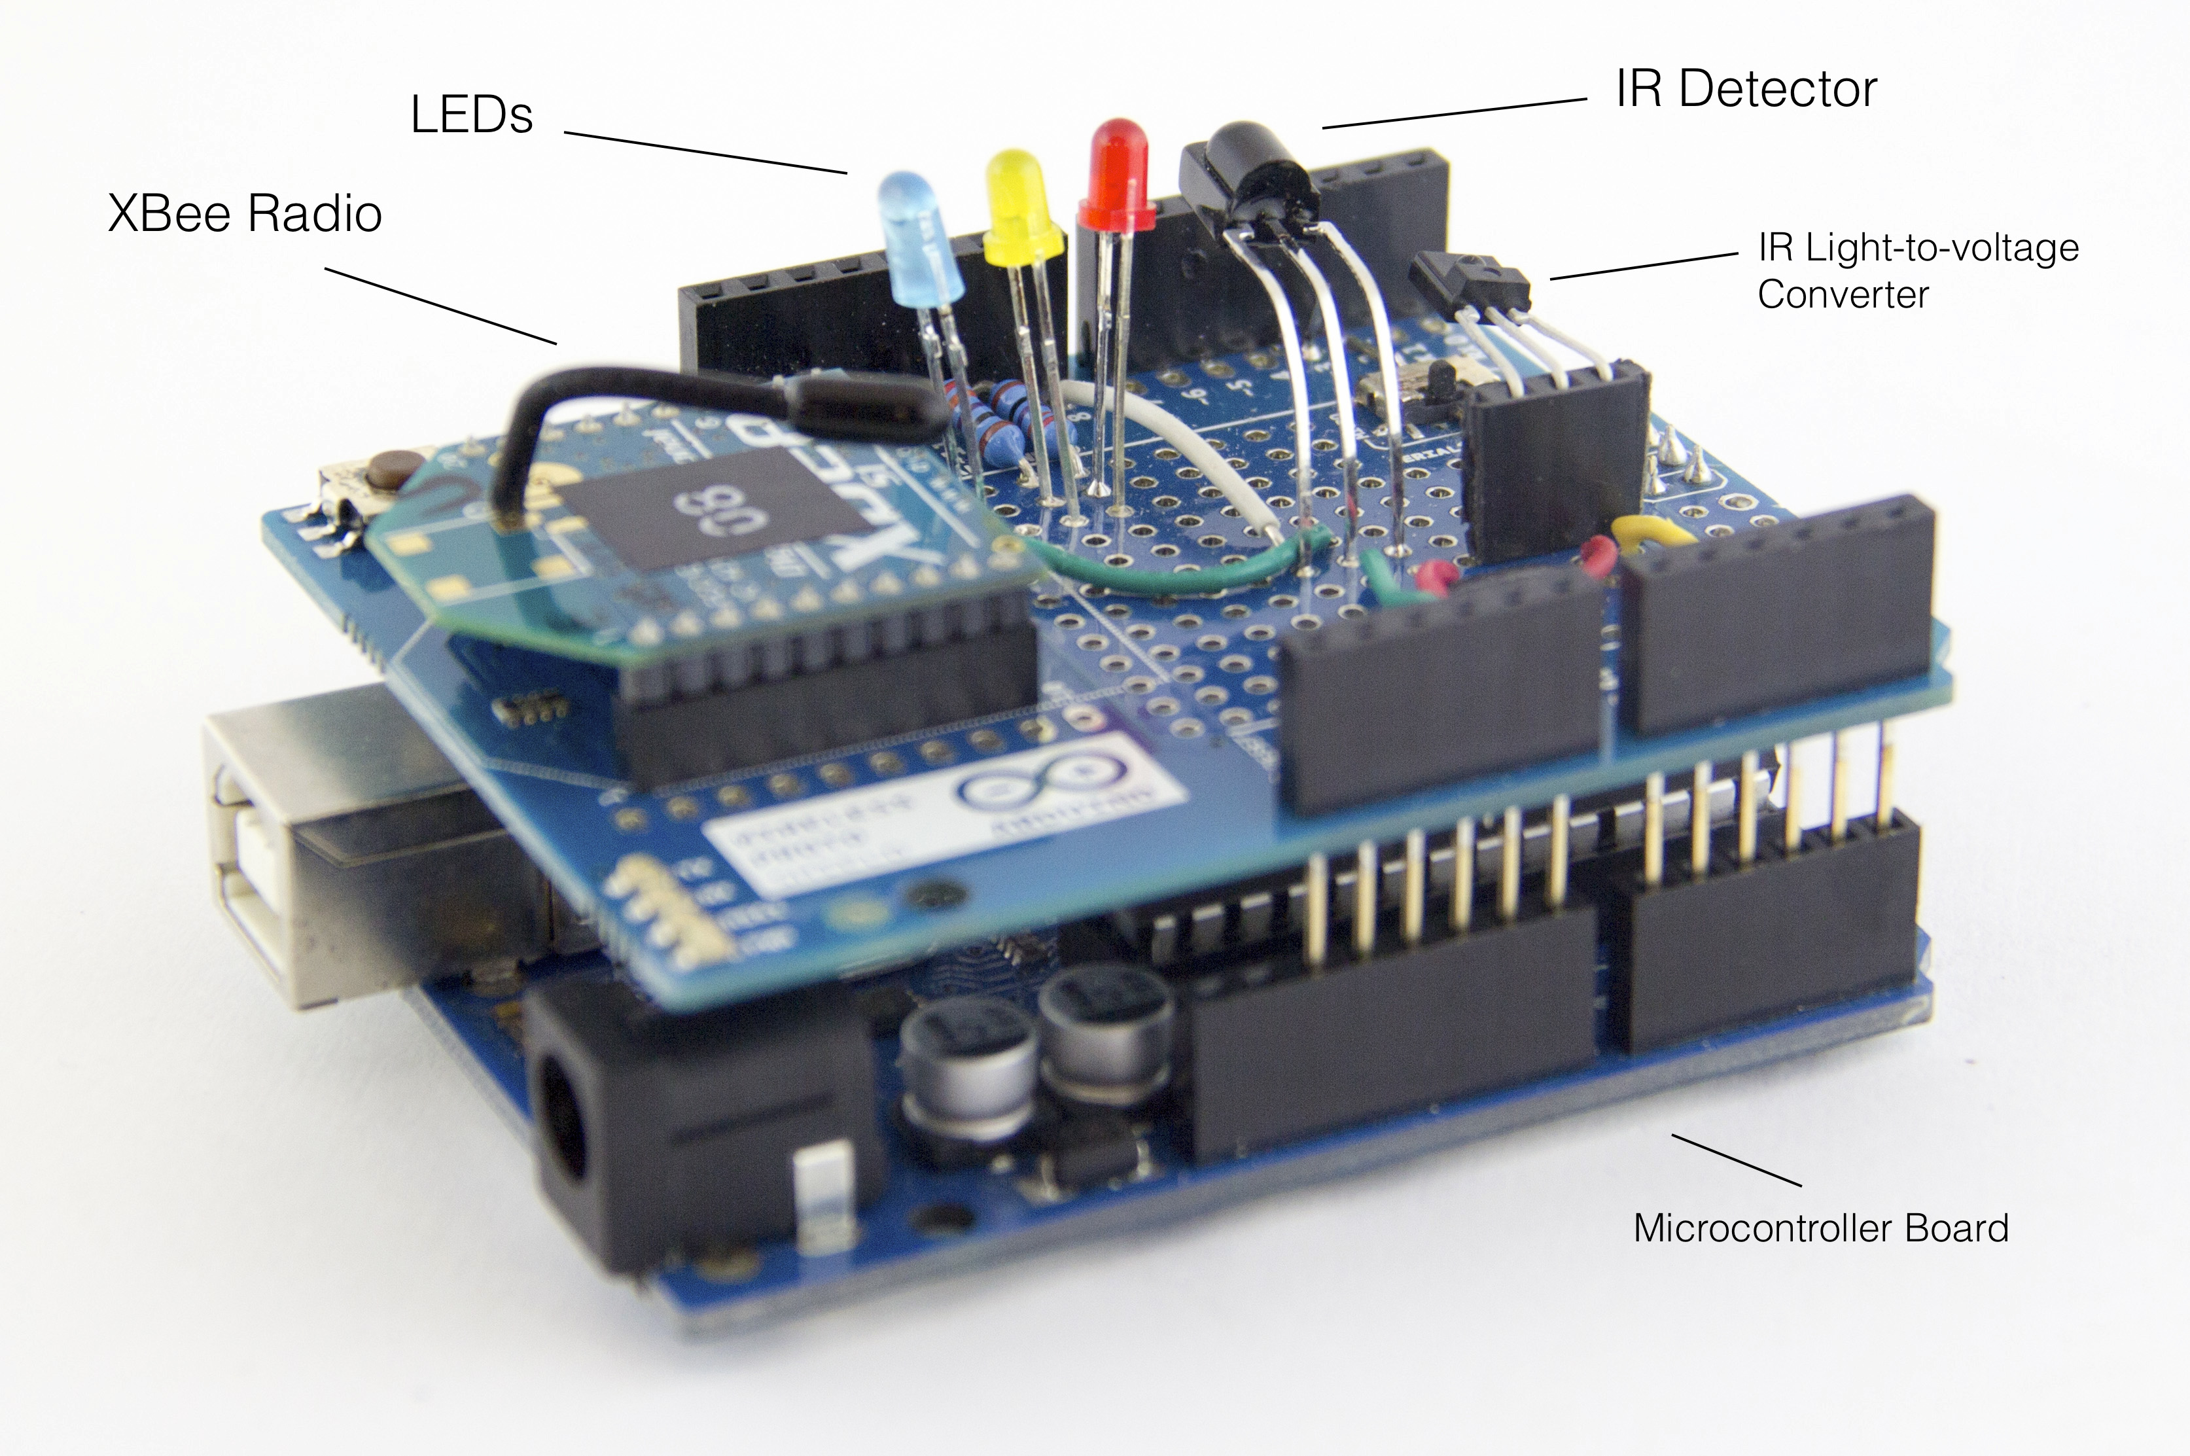

Slide 5
1
1
1
3
3
3
2
2
2

Slide 6
target acquired?
save current
head orientation
<x, orientation_{x}>
IR set absolute reference
learning
Head Motion?
IR set absolute reference
orientation
map
prediction

Slide 7
Single target received IR?
Target received IR?
Change
selection
YES
Tap
YES
NO
NO
Feedback ON
Disambiguation UI
(alphabetical)
Feedback OFF
Swipe
down
Tap selection
Select Target
TRACKING
SELECTION

Slide 8
Single target received IR?
NO
Target received IR?
YES
Tap
IR intensity winner?
YES
NO
Change
selection
Feedback ON
Feedback OFF
Swipe
down
YES
NO
Disambiguation UI
(IR intensity ordered)
Tap selection
Select Target
TRACKING
SELECTION

